Slide 1



Computational Ethics
Janvi, Karthik, Nikitha and Jayati
Prof. Srinath Srinivasa
Nov 16th-18th, 2022

Slide 2
Overview
Introduction to Computational Transcendence
Applications of CT
Computational Ethics
Intrinsic Motivation
Supply Chain
Utilitarianism
Affiliation
Traffic Management
Deontology
Achievement
Virtue Ethics
Power

Slide 3
Computational Transcendence

Slide 4


Dilemma of Responsibility
Individually beneficial
With a collective / long-term cost
Individually suboptimal / costly
Collectively good
Irresponsible Choice
Responsible Choice
Notes:
We define responsible behaviour by an autonomous agent as selecting an action which is aligned towards collective welfare even in the presence of lucrative alternate but irresponsible actions, which are individually beneficial (and hence, rational) for the agent.

Slide 5
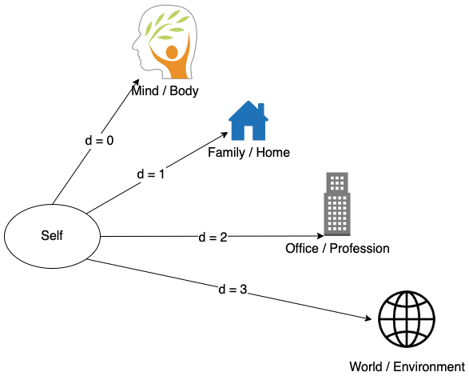
Elastic Sense of Self
We humans have elastic identities, we care not just about ourself, but also about our family, team members, environment,
world etc.
Notes:
identity

Slide 6


Computational Transcendence
Transcendence can be defined as the capability of an autonomous agent to virtually extend its identity to multiple aspects like agents, groups and concepts to different extents in a system.
Rational Association
vs
Association of Identity
Icons by Flaticon
Notes:
Rational association is driven by self-interest, and exists only as long as the association serves our self-interest.
With Association of identity, the other agent becomes a part of our sense of self, and its interests become part of our self-interest.
It’s not transactional.

Slide 7
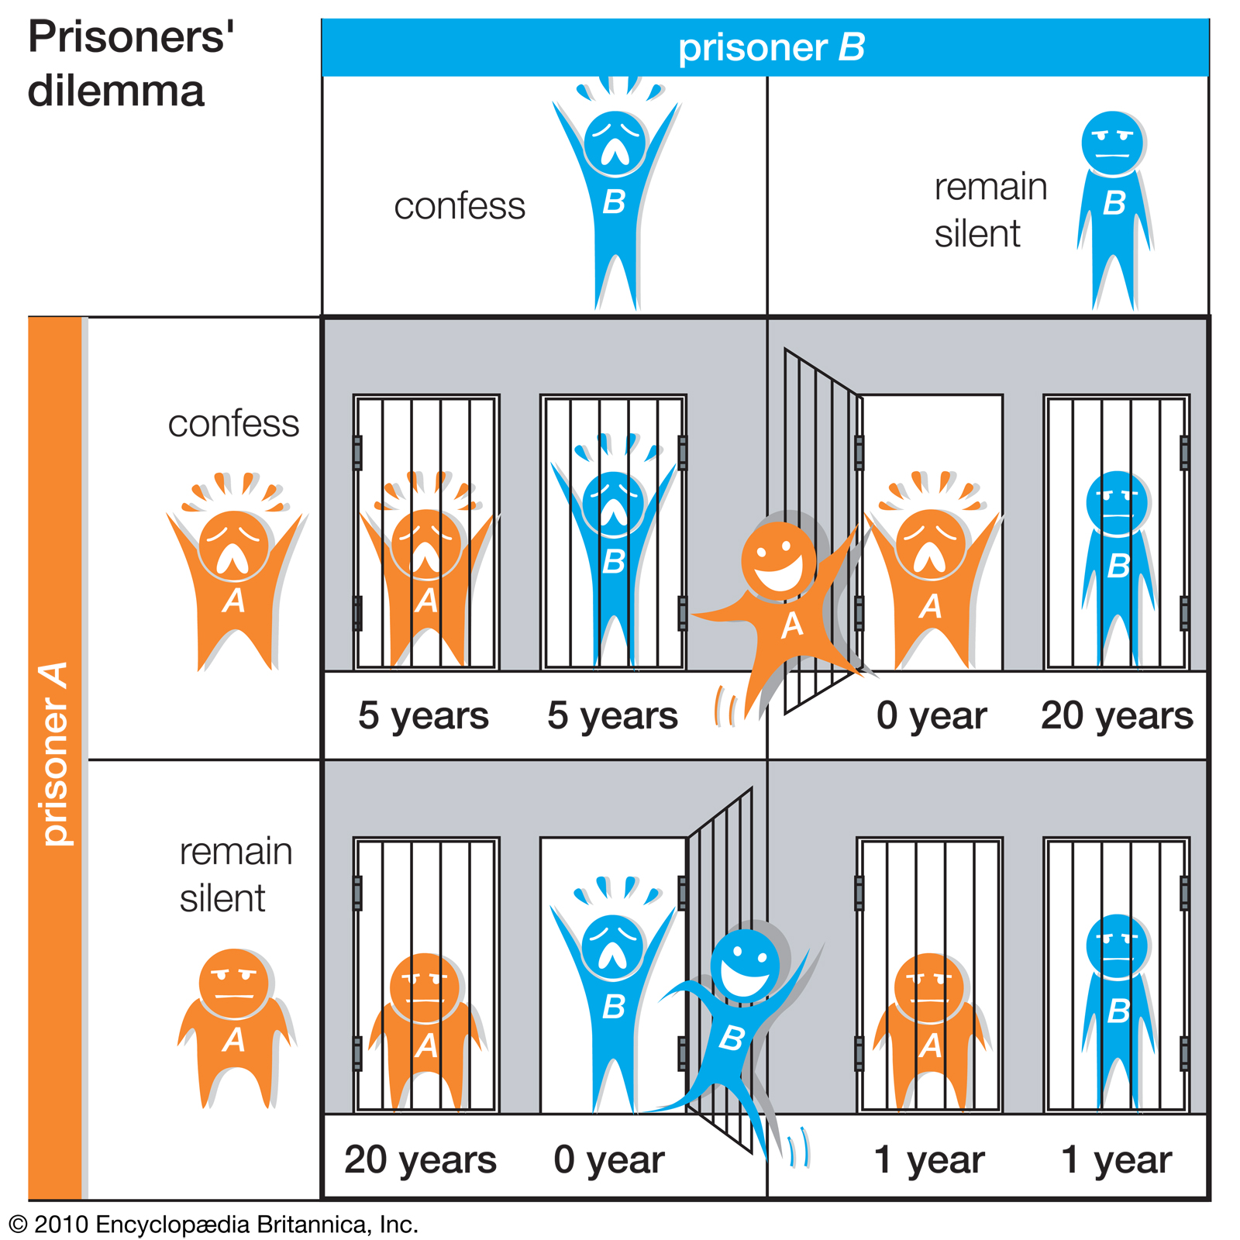
Prisoners’ Dilemma
Prisoners’ dilemma is popular in game theory. It demonstrates the dilemma of an agent to either:
Cooperate for mutual reward
Or
Defect for individual reward
This represents the dilemma of responsibility.
Image Credits: Encyclopaedia Britannica, URL: https://www.britannica.com/science/game-theory/N-person-games#/media/1/224893/85154

Slide 8
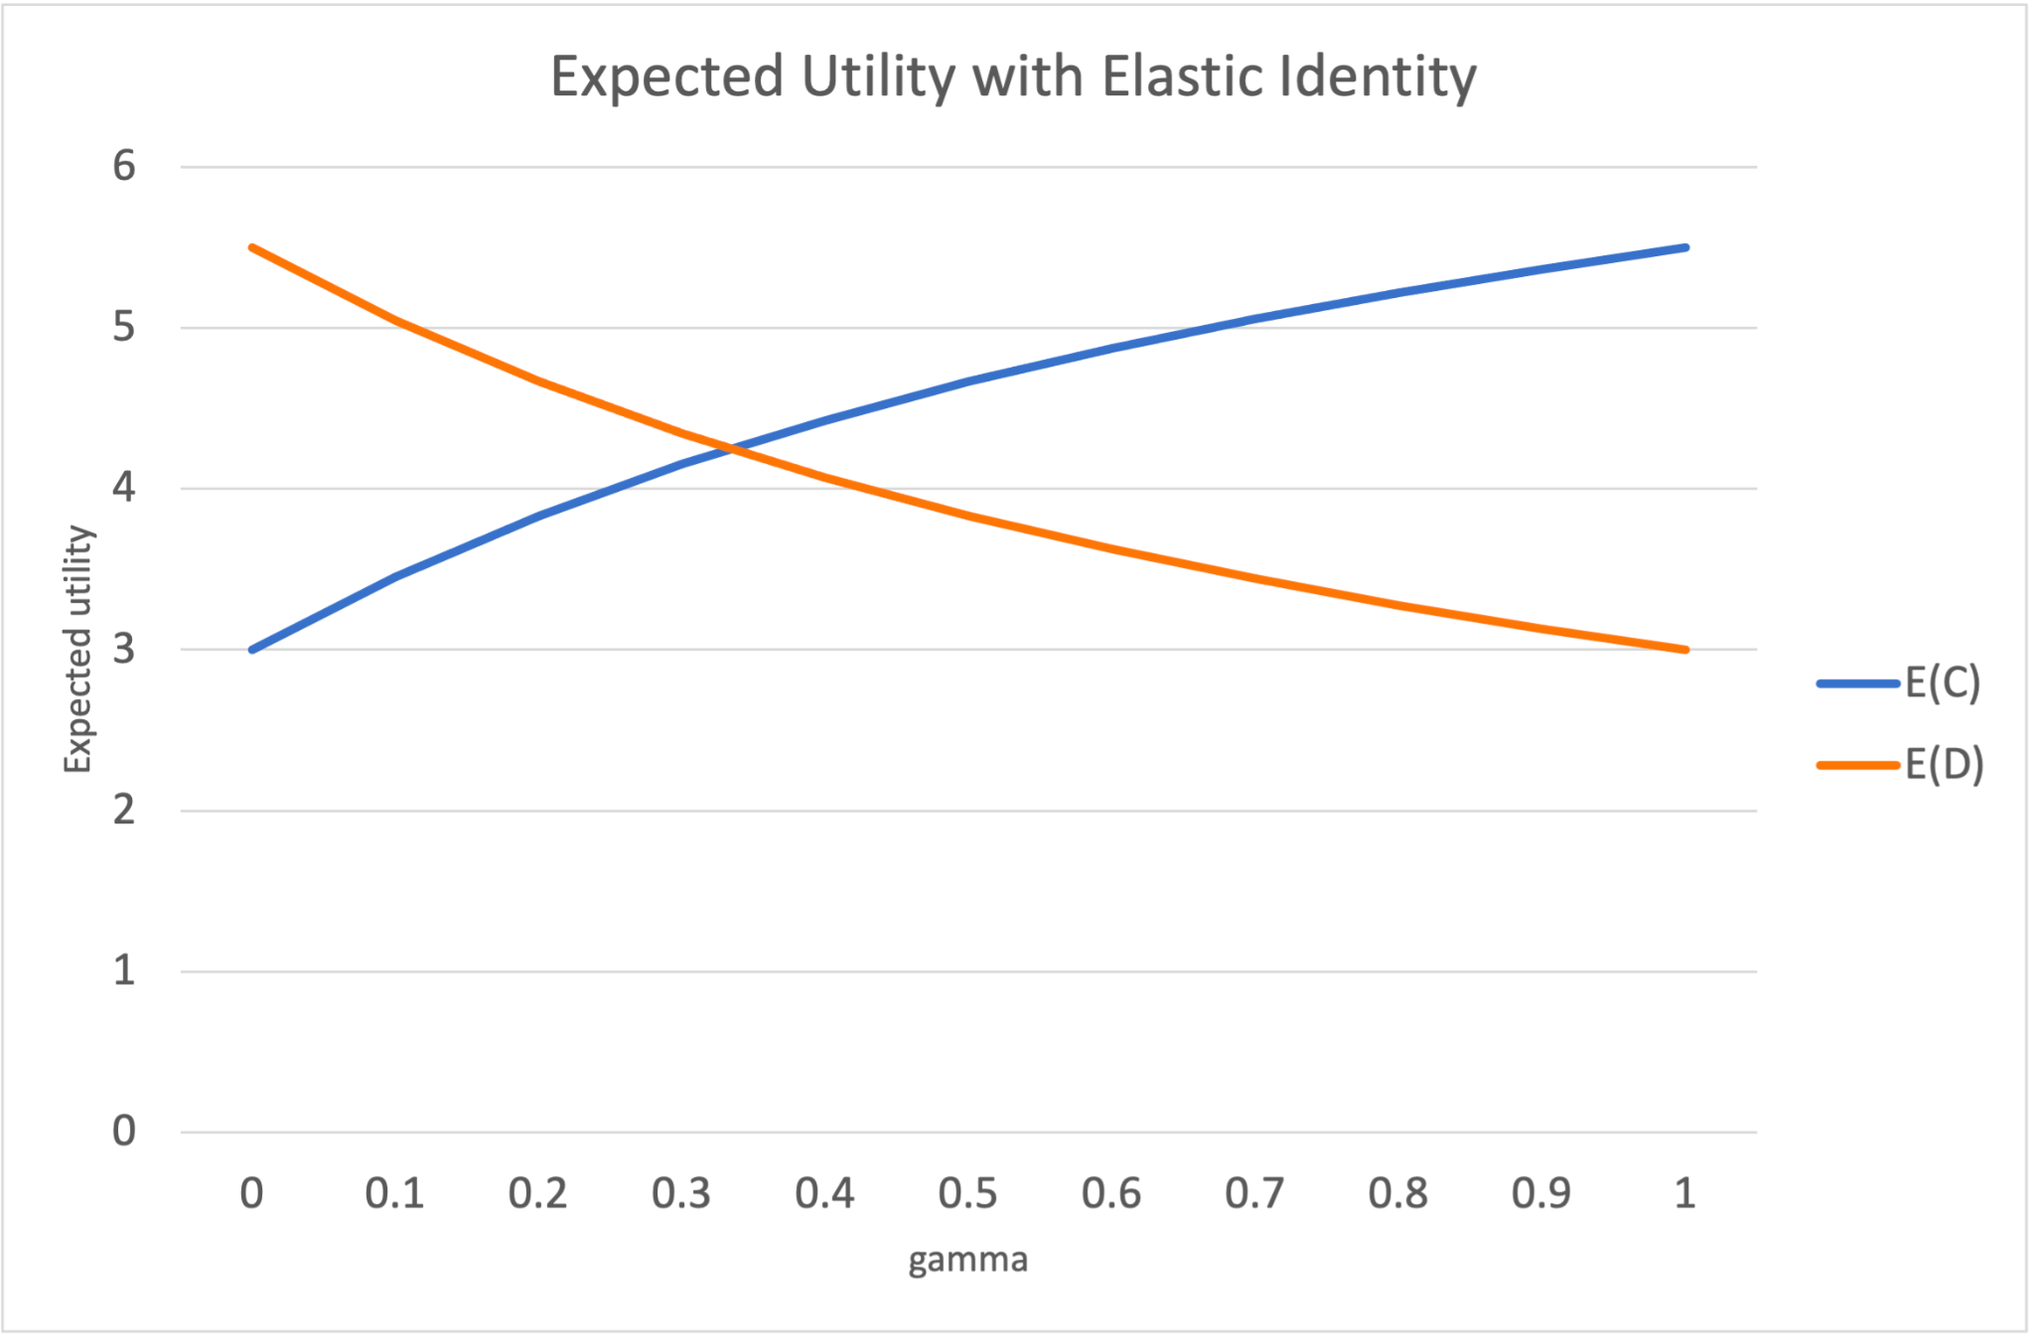
Transcendence in Prisoners’ Dilemma
More an agent cares about others (transcends),
the more it demonstrates responsible behaviour (cooperates).
C - Cooperate, D - Defect, gamma - extent to which the agent cares about others

Slide 9
Transcendence in
Supply Chain

Slide 10

Supply Chain Setup
Customer: Places orders
Industry: Generates products
Intermediary: Ships orders
Icons by Flaticon

Slide 11


Dilemma in a Supply Chain
OR
Wait to accumulate more orders?
Ship all the orders received so far?
Icons by Flaticon

Slide 12
Supply chain Efficiency Indicators
Total Cost - storage cost, transportation cost
Total Utility - profit on fulfilling orders
Average Delay Per Order - time taken by orders in supply chain

Slide 13



Types of Agents
Selfish Agent | Virtue-Delay Agent | Transcended Agent
Minimizes its costs. | Minimizes delay of orders. | Accounts for other agents in its neighbourhood.
Icons by Flaticon

Slide 14
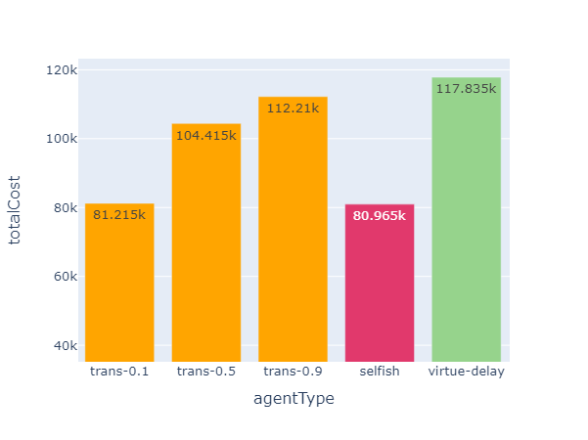
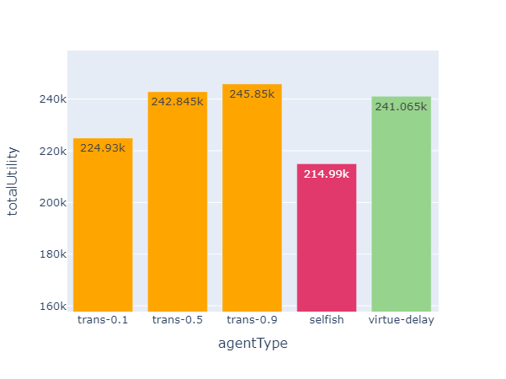
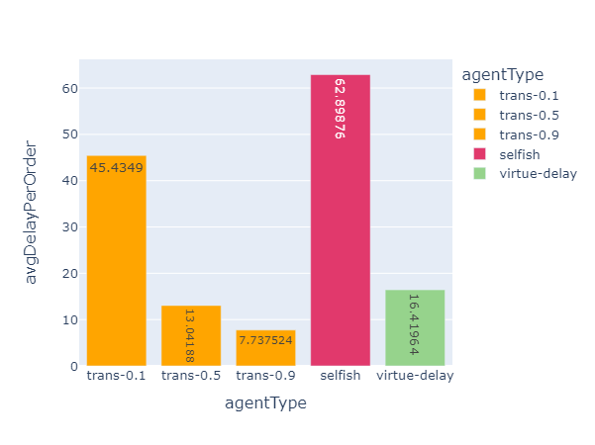
Results
Total Cost
Total Utility
Avg delay per order
Although transcended agents incur high cost, they also gain higher utility and have lower average delay per order.

Slide 15
Transcendence for
Traffic Management

Slide 16

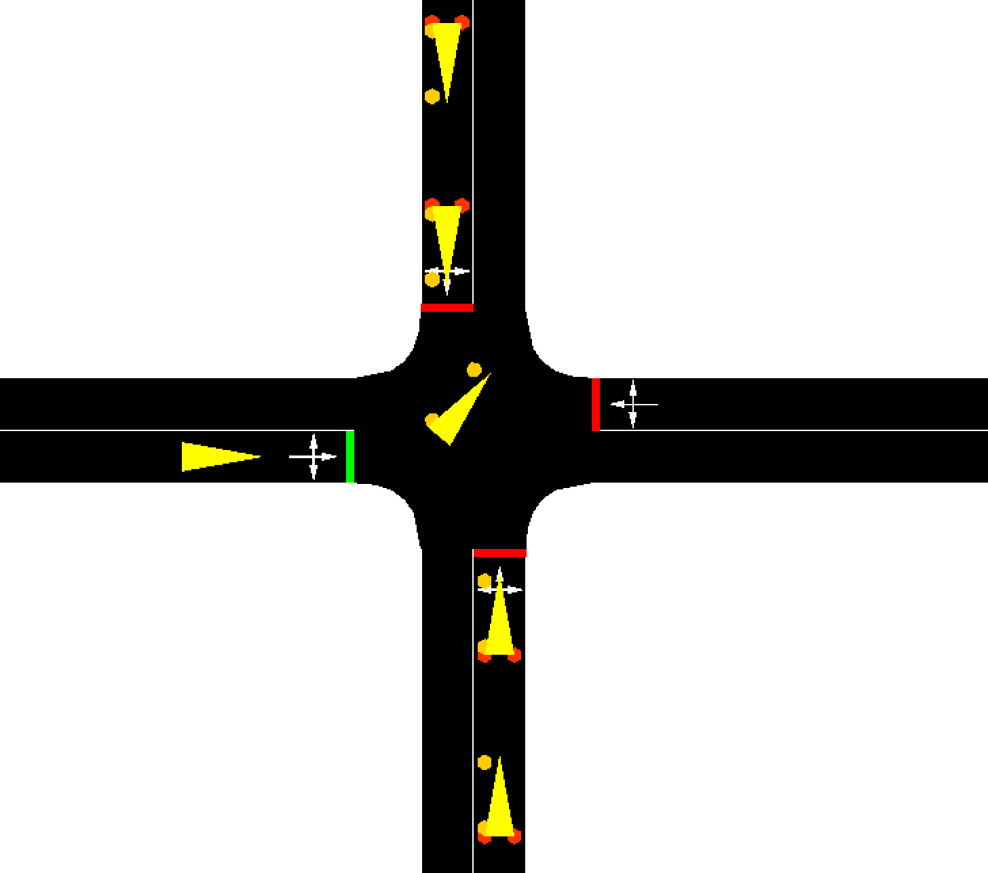
Traffic Light Setup
A 4x4 road grid with traffic lights at each intersection.
A zoomed in view of an intersection.

Slide 17
Types of Traffic Lights
Type | Description
Cyclic | Turn green for roads cyclically in a fixed loop.
Max Queue Length | Turn green for the road with max queue length.
Max Waiting Time | Turn green for the road with max waiting time.
Transcended | Turn green so as to ensure smooth traffic flows at own and neighbouring intersections. Care about the waiting time of vehicles passing through the intersection.

Slide 18
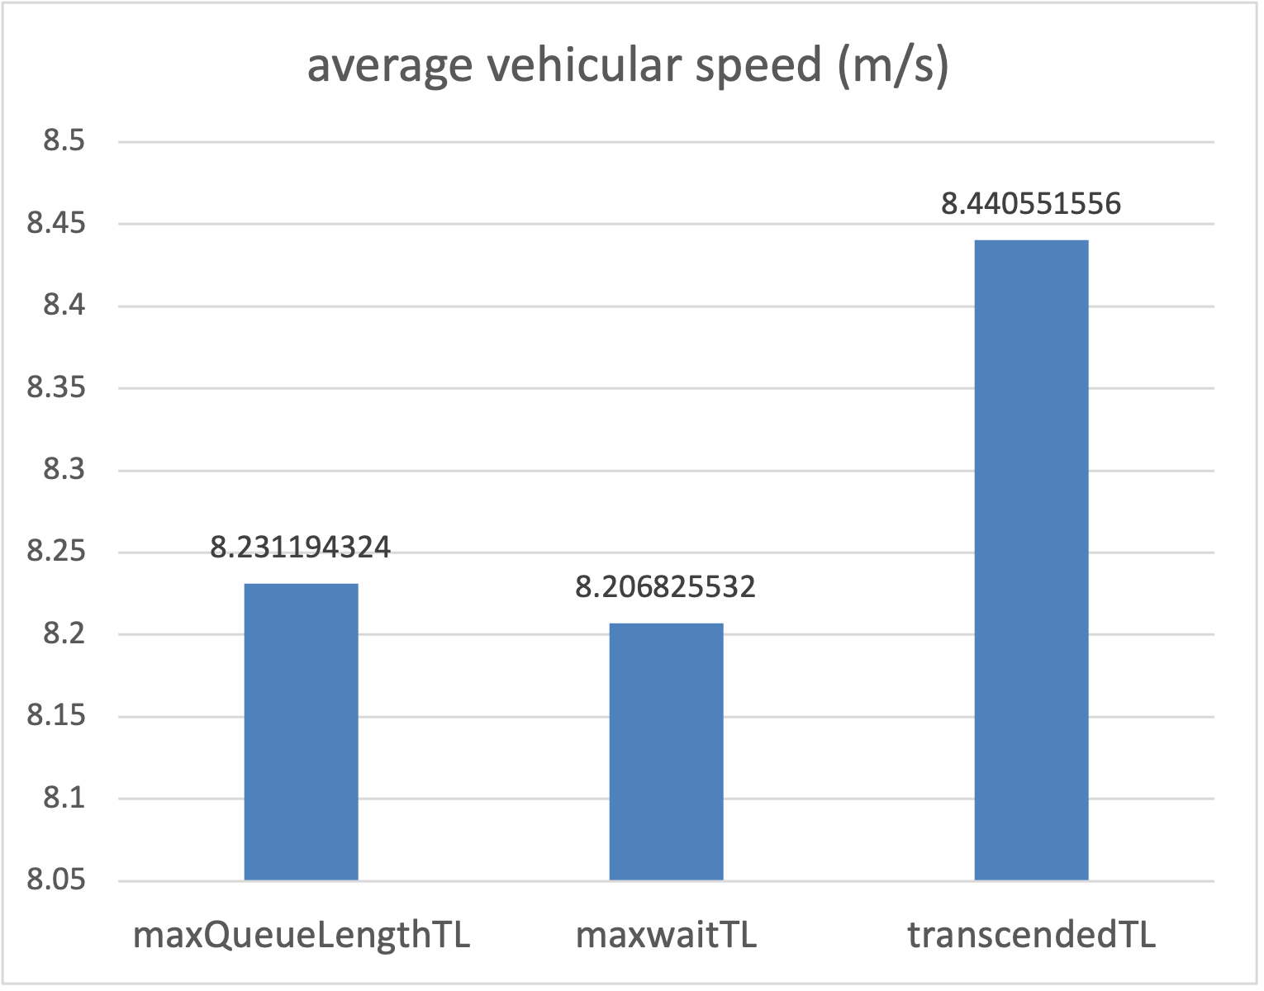
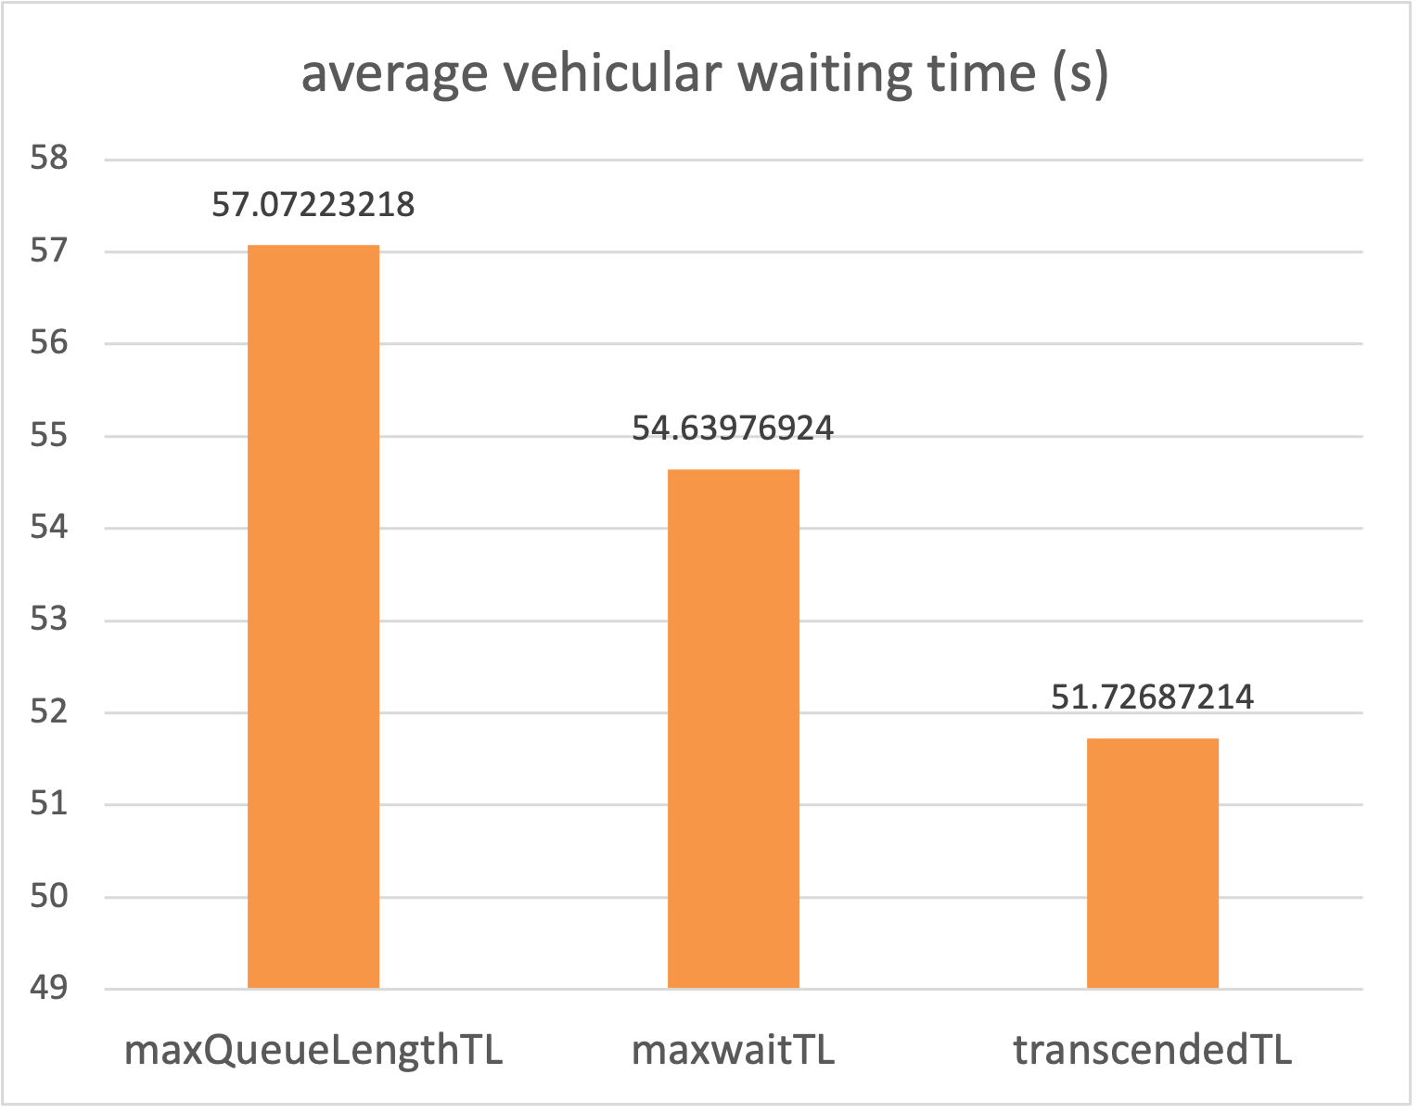
Results
Transcended traffic lights perform better than other types of traffic lights!

Slide 19
Computational Ethics

Slide 20


Ethical Agents
Icon | Ethical Agent Type | Description
 | Utilitarian | Maximizes collective utility of all stakeholders.
 | Deontic | Learns from others and responds accordingly.
 | Virtuous | Upholds context specific virtues.
 | Transcended | Accounts for others in the system and then responds.
 | Adversarial | Acts selfishly.
Icons by Flaticon

Slide 21



Ethical Dilemma of a Doctor in a pandemic
Utilitarianism
Number of lives saved at home vs hospital.
Deontology
Get the population opinion and act accordingly.
Virtue Ethics
Uphold virtue of care.
Transcendence
Account for family, patients and hospital.
Adversarial
Only care about self and family.
Icons by Flaticon

Slide 22
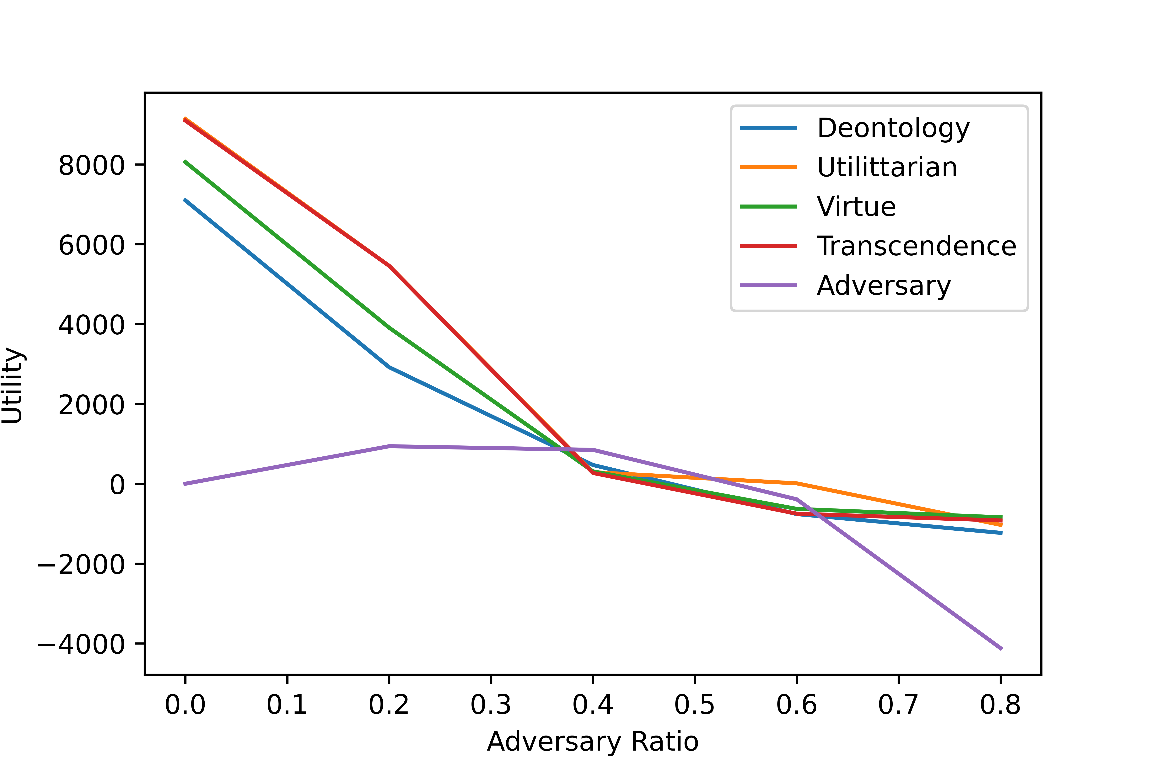
Results
As the adversary ratio increases:
Utility of all ethical agents decreases!
After a certain threshold, even the utility of the adversarial agents decreases (purple line).

Slide 23
Intrinsic Motivation

Slide 24
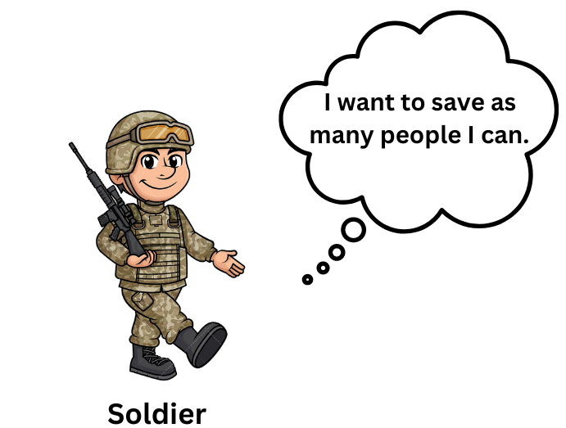
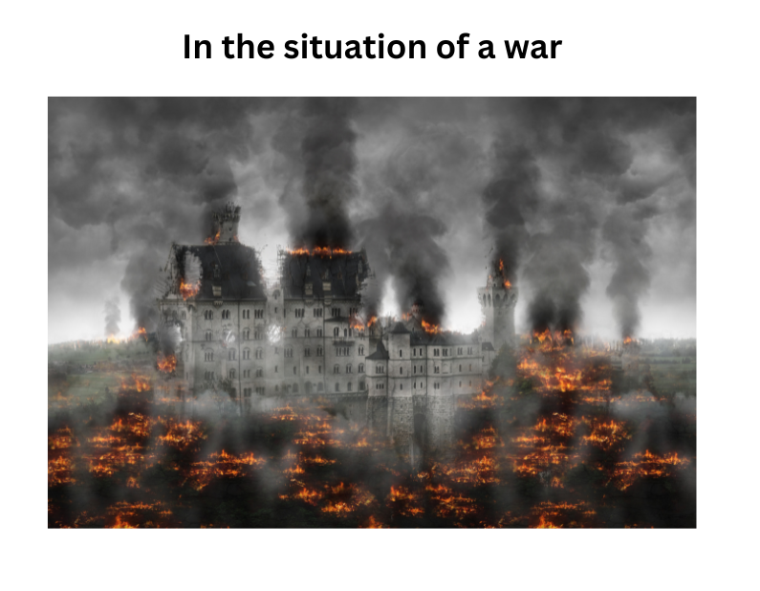
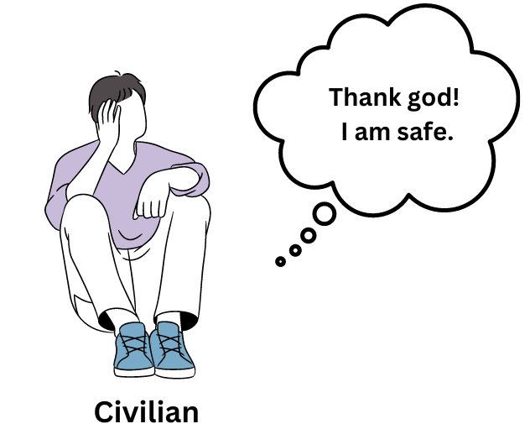
The idea of Intrinsic Motivation..
People can perceive same external situation in different manner.
That’s where intrinsic motivation comes in!
Depending on the intrinsic motivation people react to external situations!

Slide 25
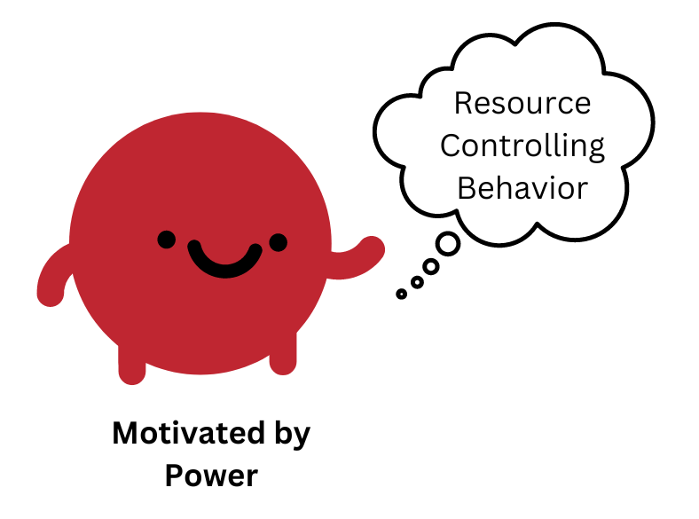
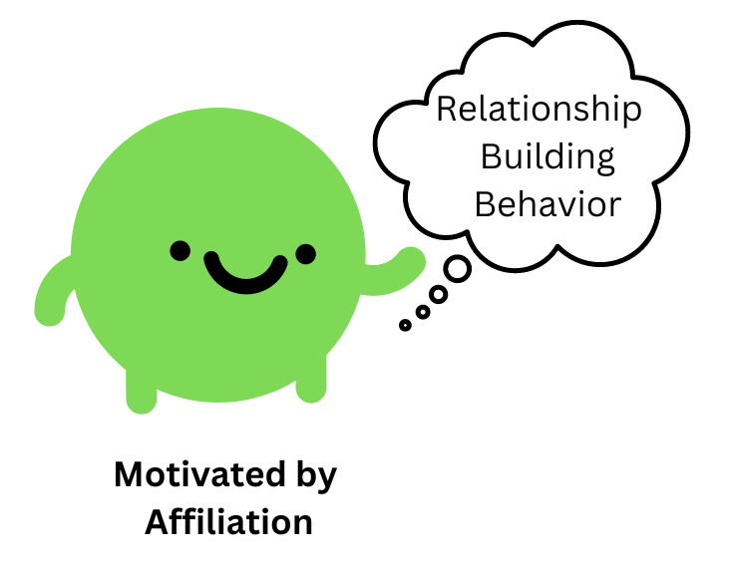
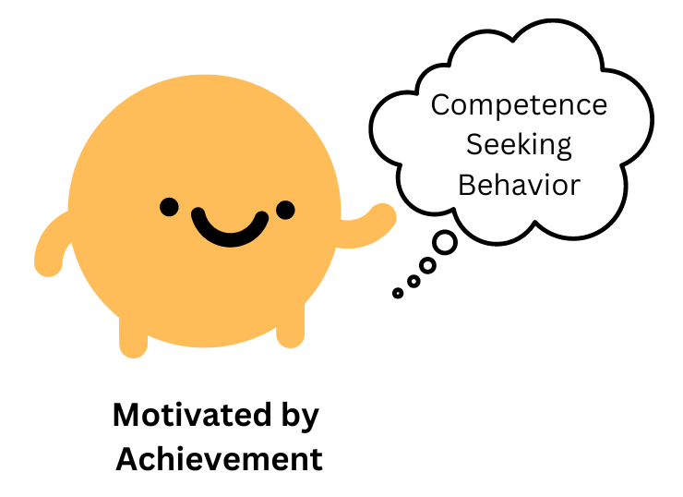
We studied three intrinsic motivations..
Also known as “Influential Trio”!
They display a diverse response to a particular situation.
They played prisoners’ dilemma game in a network.
Heckhausen, Jutta Ed, and Heinz Ed Heckhausen. Motivation and action. Cambridge University Press, 2008.

Slide 26
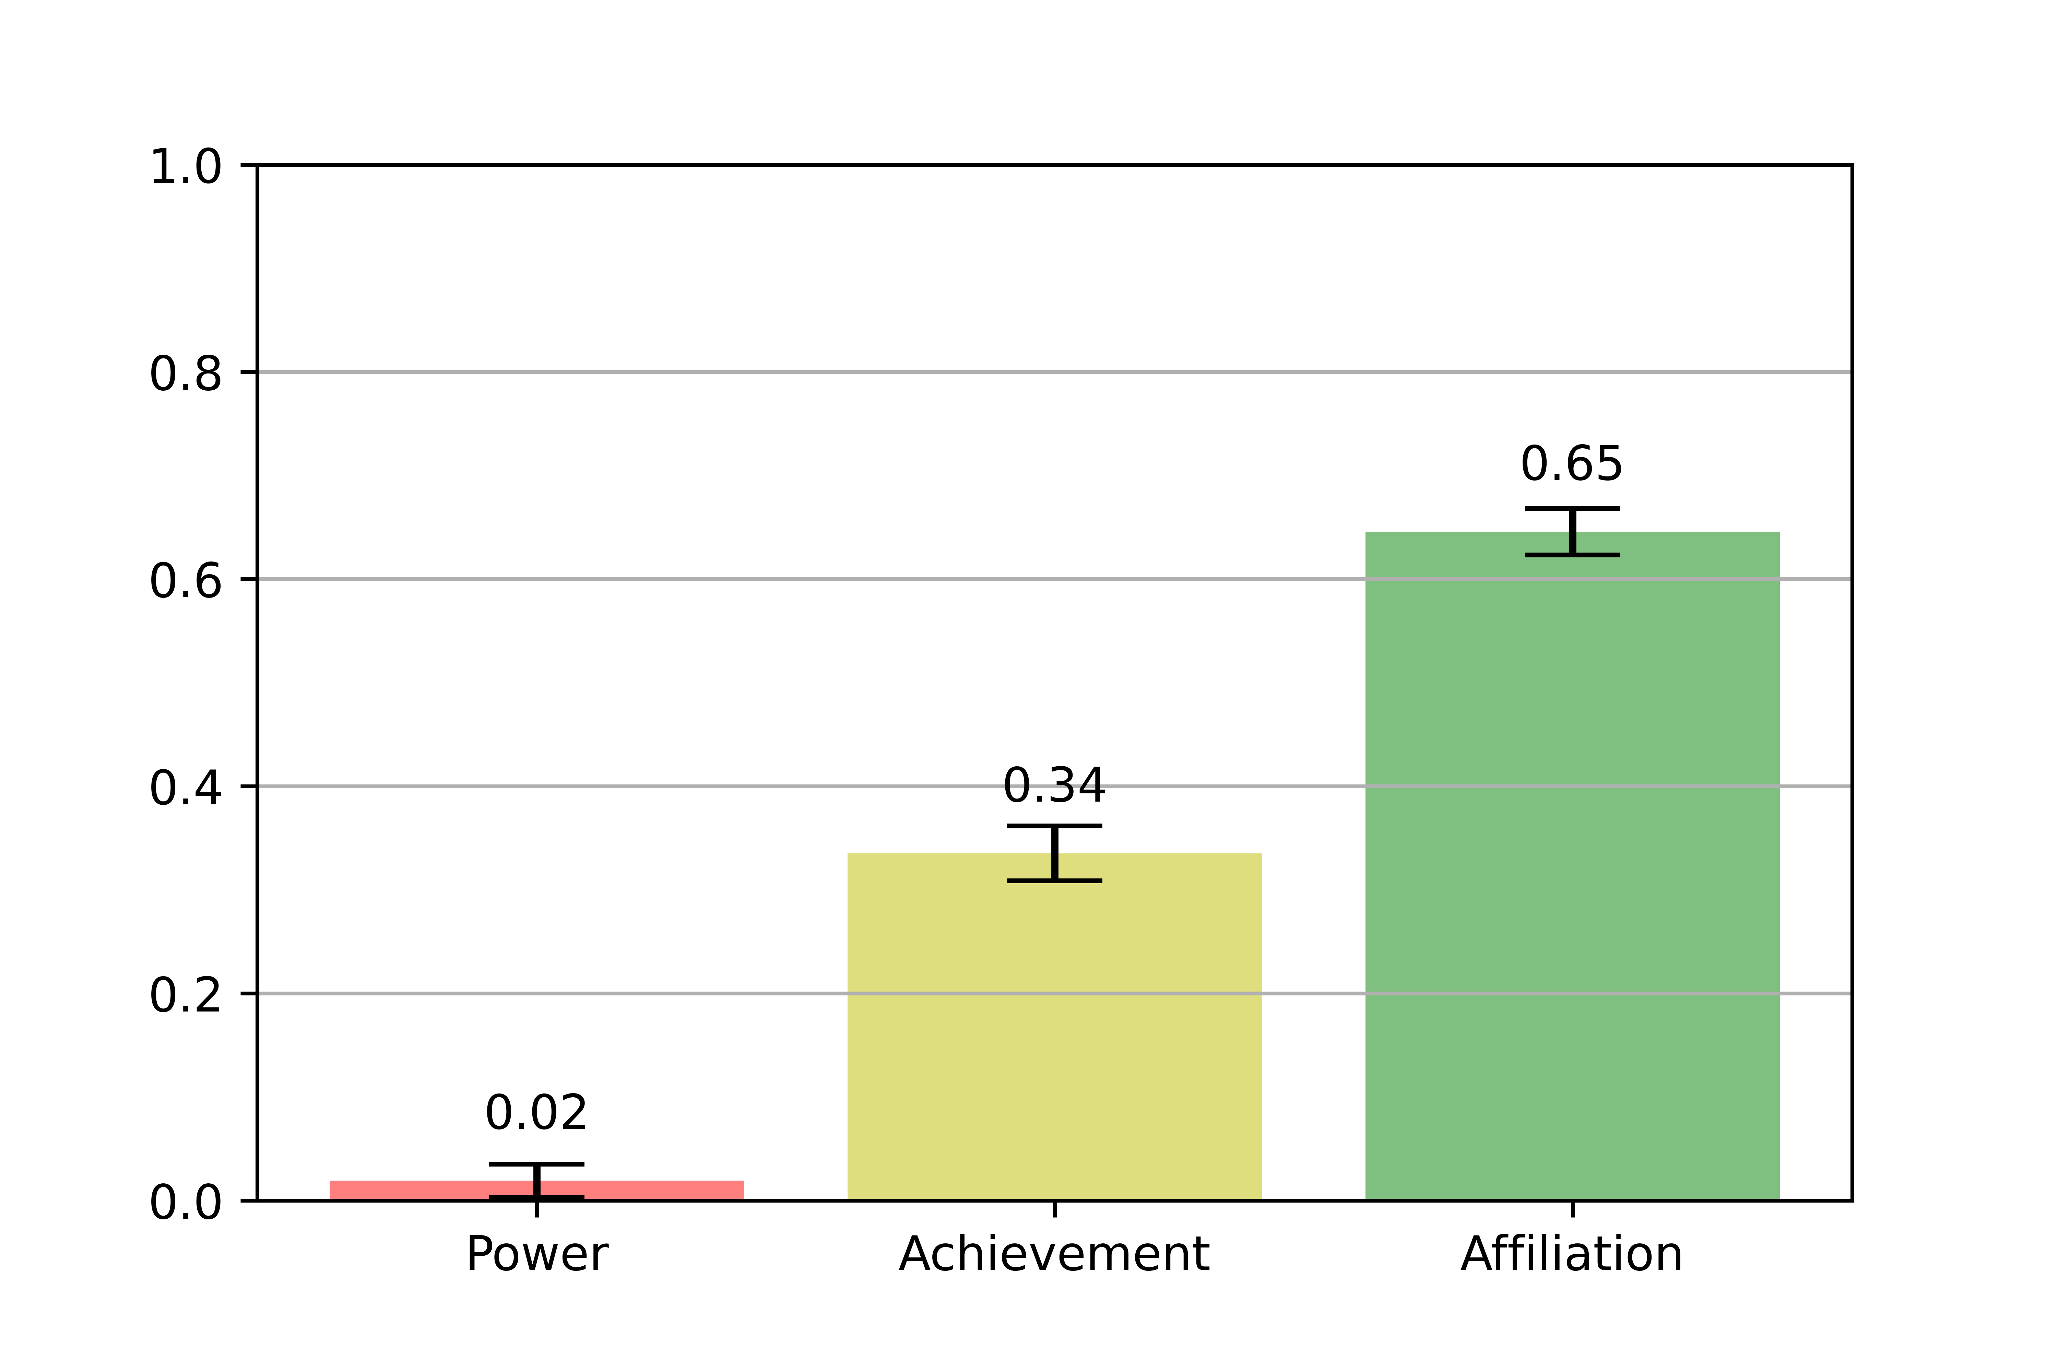
It was observed that..
For the network to settle :
Affiliation: Majority (60-70)%, who are willing to cooperate.
Power : Least (0-10)%, who display controlling behaviour towards external incentive.
Achievement : Moderate (30-40)%, who want to be treated fairly.
Hence, a lot of affiliated agents (cooperators) are required to stabilize the network!
Settled proportion

Slide 27
Our Related Publications
Jayati Deshmukh and Srinath Srinivasa. “Computational Transcendence: Responsibility and Agency.” Frontiers in Robotics and AI 9:977303. doi: 10.3389/frobt.2022.977303 [link]
Srinath Srinivasa and Jayati Deshmukh. “The Evolution of Computational Agency.” Novel Approaches to Information Systems Design. IGI Global, 2020. 1-19. ISBN13: 9781799829751 [link]
Jayati Deshmukh, Srinath Srinivasa and Sridhar Mandyam, “What Keeps a Vibrant Population Together?,” Complex Systems, 30(3), 2021 pp. 347–373. [link]
Srinath Srinivasa, Jayati Deshmukh. AI and the Sense of Self. arXiv:2201.05576 [link]

Slide 28

Team Details
Acknowledgements
Center for Internet of Ethical Things (CIET)
Prof. Srinath Srinivasa
Jayati Deshmukh
Janvi Chhabra
Sama Sai Karthik
Nikitha Adivi
Contact
sri@iiitb.ac.in

Slide 29
Thanks!

